Slide 1
Starting/default code
Convert HIV treatment data in db and calculate distances between two coordinates and lat lon location for each
Starting locations from all values in database
LATLONFROMZIPCODE: Get Latitude and Longitude from given Zip Code:
[LAT1, LON1] = LATLONFROMZIPCODE(ZIP1)
On map, have shapes appear for each location on the map
Based on lat/lon

Slide 2
User will fill out the blanks in the interface- Victoria Le
Zipcode
Maximum travel distance (miles)
Treatment type

Slide 3
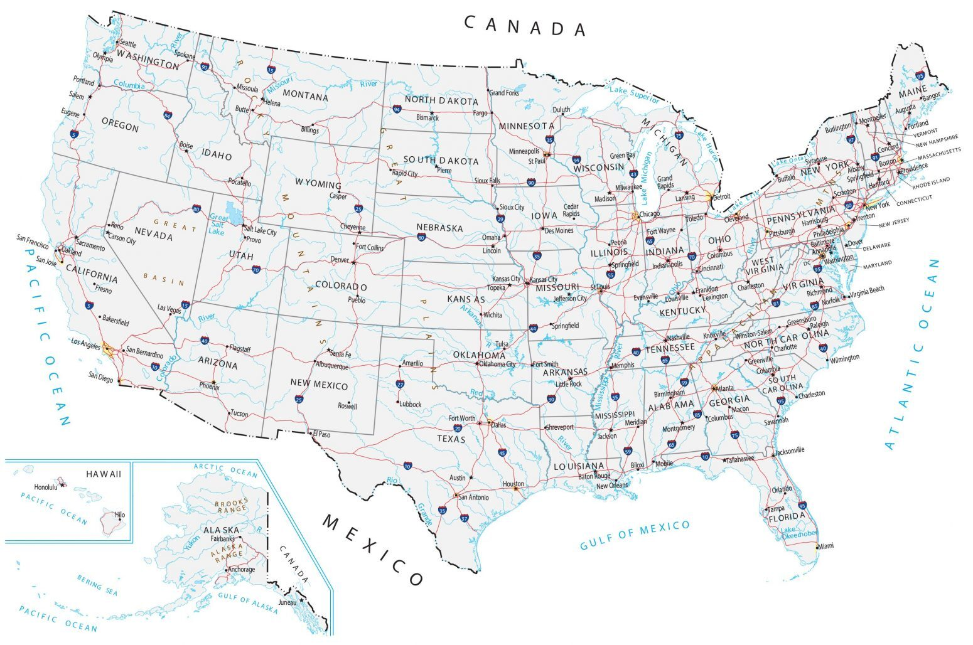
Zip code:
Maximum travel distance (miles):
Treatment Type:
SUBMIT
Notes:
Can use an image as a panel background

Slide 4
Initial values and Treatment type – Alex Dyba
If statements
If no mile radius is inputted, default value is 20
If no treatment type is inputted, display all treatments
For loop to look entire database of locations
If statement/dropdown case situation
If treatment type matches the specified one, store locations into matrix or cell
Continue until all

Slide 5
Zipcode and distance- Victoria Le
Convert zipcode to geolocation on map
For loop: Function ZipLatLon (Zip1, Zip2); output is distance in miles
Zip 1 is user zip, Zip 2 will be all the zipcodes of all the centers that were already sorted by treatment from database
https://www.mathworks.com/matlabcentral/fileexchange/45905-zip-code-latitude-longitude-city-state-county
If statement
If distance of is less than specified one, store newly sorted info in cell or table or matrix
Continue until all locations are looked through

Slide 6
Final output- Natalie Lau
Once final list of locations is created, display table in output with location name and address/zipcode
Hide all shapes on map
Unhide shapes that correspond to outputted database values on map

Slide 7
Zip code:
Maximum travel distance (miles):
Treatment Type:
SUBMIT
Name | Address
Notes:
Sort table based on distance

